Slide 1
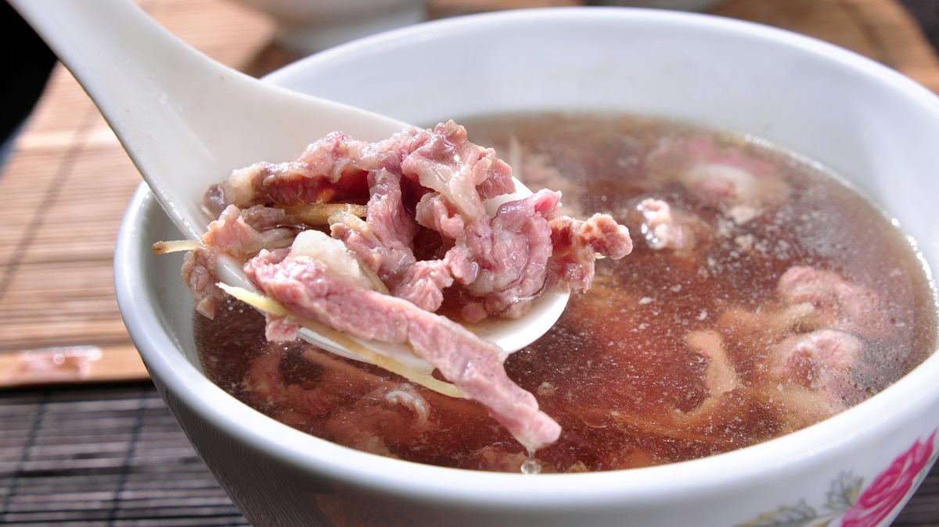
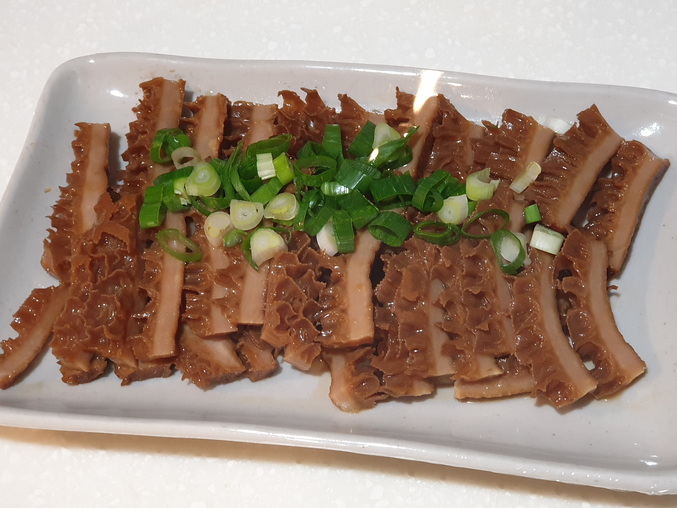





Taiwan Xiao-Chi
Differ between Northern and Southern Xiao-Chi
Northern Xiao-Chi
Southern Xiao-Chi
Shopping List
Beef Soup
Beef soup is a famous Xiao-Chi in Tainan (Tainan is really a city of food in Taiwan or even east Asia), people even go “Beef soup trip” to Tainan due to its popularity and taste. The most special feature of Tainan beef soup is it always use fresh beef which is slaughtered in one day’s dawn.
This rules of making a beef soup then leads to some interesting outcome: The stores only open from dawn to noon because no one slaughter a cow in the afternoon, also, the stores would not open at Monday and Tuesday because in Taiwanese convention, traditional market will not operate in these two weekdays.
Due to the difficulty of obtaining beef, maybe it is not possible of us to make authentic beef soup at home.
Another funny trivia of beef soup is that the price of it would vary due to what part of beef you choose in beef soup.
Besides beef soup, the stores usually have other beef cuisine for customers to eat. For example, fried beef, cow heart, cow brisket even cow stomach. Just like milkfish, Taiwanese could eat most of the part of a cow.
Braised
Cow
Stomach
Taiwan Xiao-Chi
Northern Xiao-Chi
Southern Xiao-Chi
Differ Between northern and Southern Xiao-Chi
Shopping List

